Slide 1
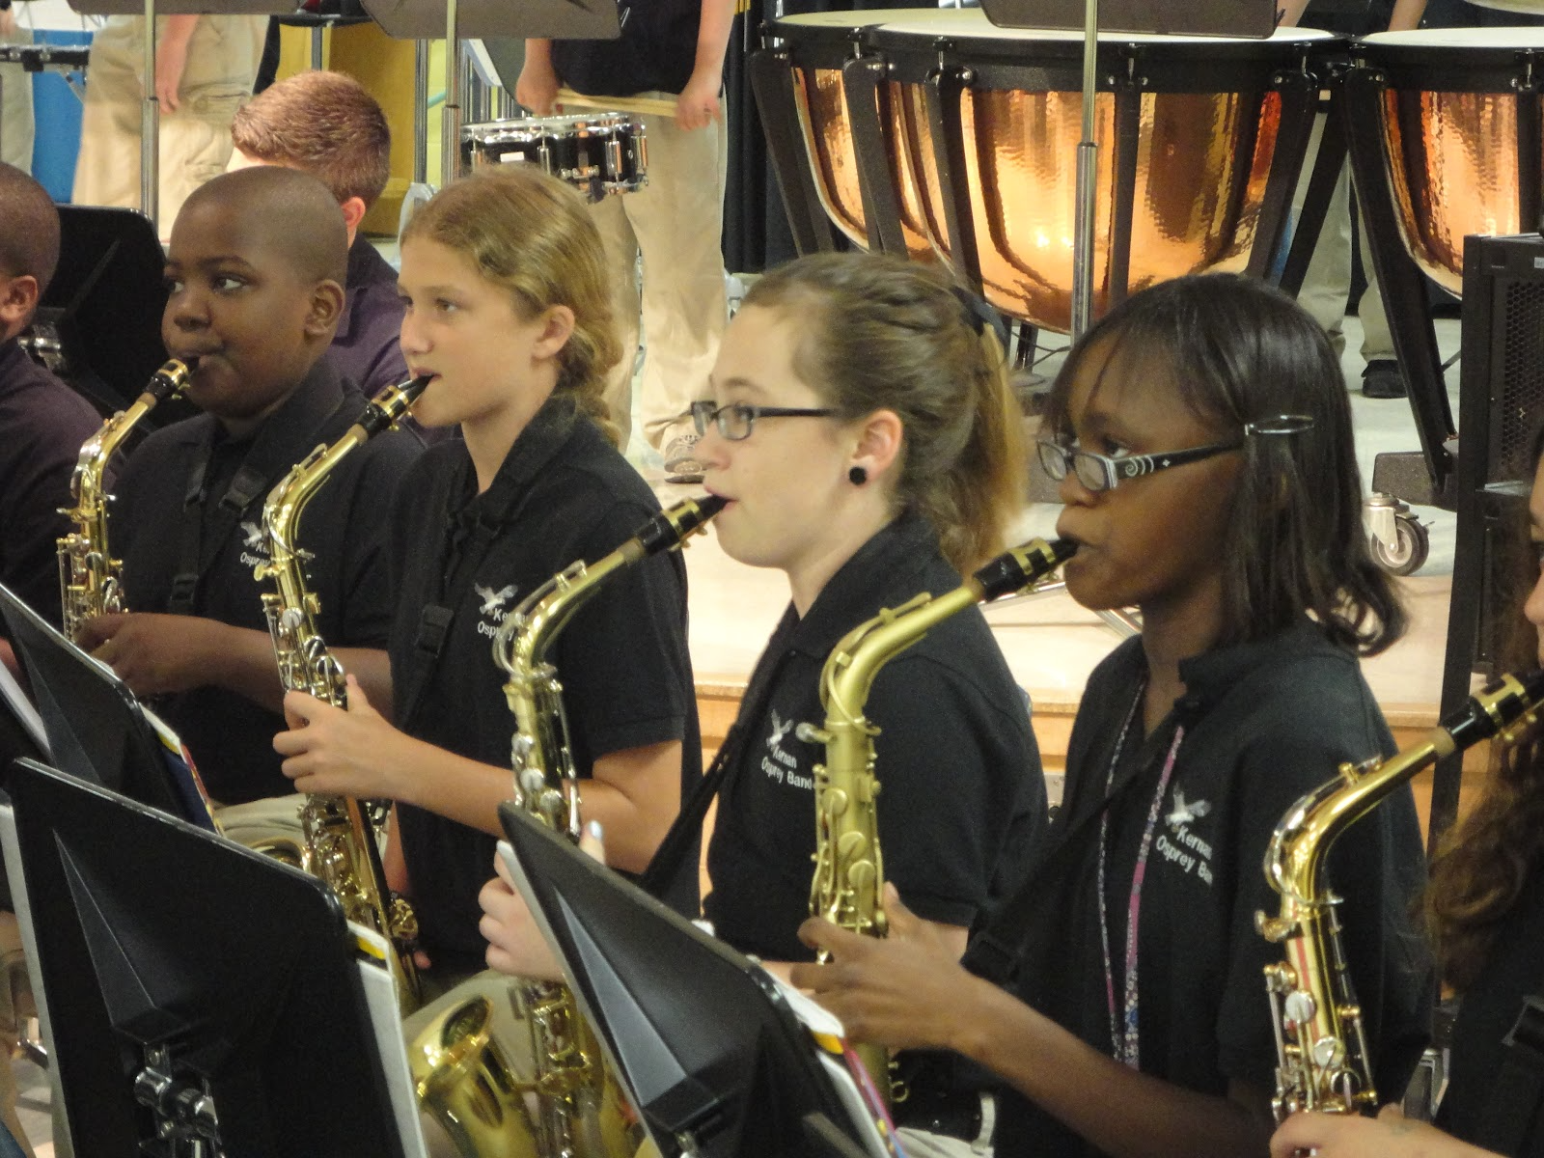
Music Performance Ensemble Options
Band – Chorus – Orchestra
Year-long classes
Includes a daily large ensemble rehearsal and a weekly small sectional that are scheduled on a rotational basis
Ensembles are ability-based.
Music teachers will be in contact with elementary programs to schedule meetings and auditions.

Slide 2
World Language Options
French or Spanish
–Students may begin French or Spanish in 7th grade.
–Year-long classes offered every day for 50 minutes.
–Students receive high school credit for successfully completing MS world language courses.
Notes:
EDIT FOR WHAT YOUR SCHOOL OFFERS
Students have the option to take World Language during middle school. This enables students to complete at least level one during middle school and pursue World Language study through the Advanced Placement level during high school.

Slide 3
Additional
Courses
Family and Consumer Science
Technology Education
Reading and/or Math Intervention
Innovation & Inquiry Reading Modules
GT Research
Notes:
SCHEDULING NOTES:
Students who are reading on or below grade level will take at least two quarters of reading in 6th grade, one of which will be a reading skills transitional module, unless the students are enrolled in a reading seminar.
Selecting both Music Performance and World Language will only allow a student to enroll in one of the related arts (Art, Family and Consumer Science, General Music, and Technology Education). Students must take Family and Consumer Science in grades 7 or 8 in order to meet the COMAR financial literacy requirements. (Someone please check this)

Slide 4
A Possible Sample Schedule
Period | Time | Class
 | 7:55 | Students enter building
Period 1 | 8:13 - 9:05 | Academic
Period 2 | 9:07 - 9:57 | Academic
Period 3 | 9:59 - 10:49 | Academic
Lunch | 10:51 - 11:21 | Lunch
Period 4 | 11:24 - 12:13 | Academic
Period 5 | 12:15 - 1:05 | Academic
Period 6 (A/B) | 1:08 - 1:58 | Related Arts
Period 7 (A/B) | 2:00 - 2:50 | Related Arts
 | 2:55-3:00 | Walkers Dismissed

Slide 5
Finding the Right Balance Between
- Course Placements
- Rigor
- Personal Interests
- Student Success
Notes:
HCPSS is committed to ensuring that all students are working to a balance between course placements and personal interests to ensure a balanced schedule that engages students in the learning process.

Slide 6
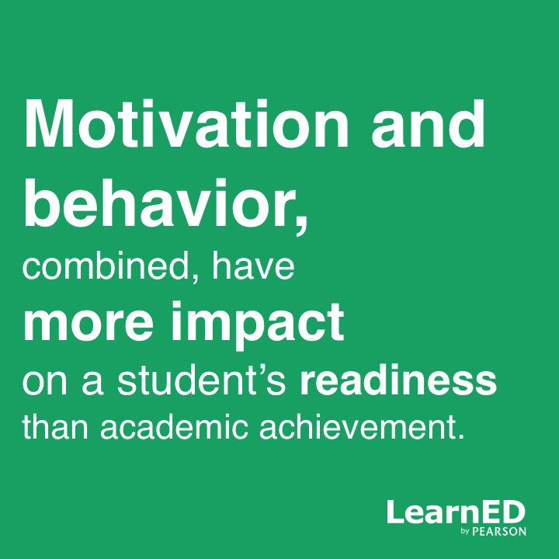
Student Behavior

Slide 7
The earlier a student develops important academically related behaviors, the more likely these behaviors are to become a habit.
Source: The Forgotten Middle: Ensuring that All Students Are On Target For College and Career Readiness Before High School, ACT, 2008.

Slide 8
Supporting Academic Behaviors
At Hammond Middle, staff and students:
Start with the goal in mind
Do what they do best, every day
Celebrate effort and achievement
Engage in positive experiences each school day
Create excitement for the future.
Notes:
You may want to customize.

Slide 9
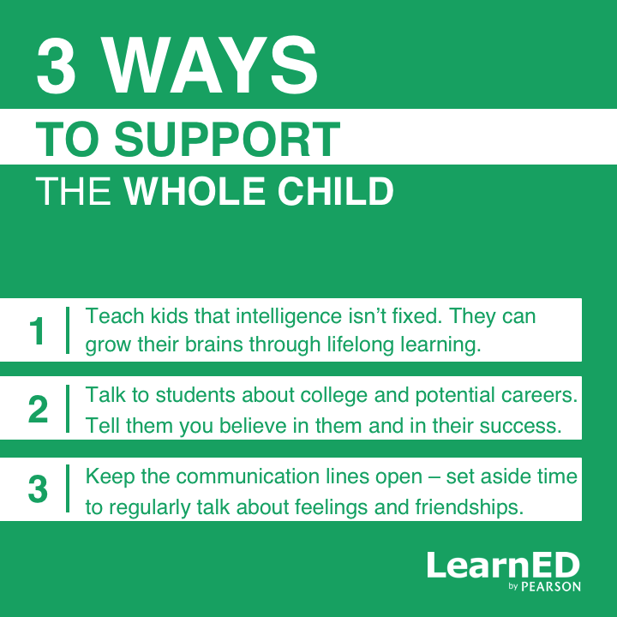

Slide 10
Supporting Positive Student Behaviors
Tips For Parents
Ensure that your child has the materials and place to study at home.
Set a regular time for homework.
Encourage your child to be responsible for chores and homework.
Provide your child with a range of experiences to allow him/her to identify areas of strength.
Talk to your child.

Slide 11
Important Dates
Date | Activity
May 22, 2018 | Fifth Graders Visit
Thursday, August 30, 2018 | New Student Orientation
October 16-18, 2018 | Outdoor Education

