Slide 1
WORKING TOGETHER TO ENSURE A SUCCESSFUL TRANSITION TO MIDDLE SCHOOL
Building a Strong Foundation for High School and Beyond

Slide 2
Meet the Staff
Dr. Dale--Principal
Ms. Smith--Assistant Principal
Mr. Seagroves--6th Grade Team Leader
Ms. Sheffield--6th Grade Counselor
Mr. Ebbe--Gifted and Talented Resource
Mr. Pendley--Band
Mr. Reinhardt--Orchestra
Mr. Griffiths--Chorus
Ms. Koehler--Media Specialist
Ms. Rudacille, Mrs. Wood, Ms. Barrack--Office Secretaries
Mrs. Frick--School Nurse
Mrs. Richard--MIST

Slide 3
WORKING TOGETHER
TO PROVIDE
A WORLD
CLASS
EDUCATION
Notes:
A world-class system inspires and engages every student to discover and reach their full potential. A world-class system fulfills the promise of preparation to every student. This means that each student graduates with the requisite knowledge and skills– without taking remedial courses– to succeed in their choice of college or a livable-wage career.
To deliver on this promise, we will equip our students to thrive in a future that is certain to look very different than it does today. We want our students to stand shoulder to shoulder with the top students from any nation. And, we want them to be able to continue to adapt in step with the world around them.
The promise of preparation applies to every student, regardless of race, ethnicity, disability, language acquisition, or socioeconomic status. We must focus on the individual needs of every child, which is essential as our population rapidly grows and diversifies.

Slide 4
The Promise of Preparation
Vision
Every student is inspired to learn
and empowered
to excel.
Mission
We cultivate a vibrant learning community that prepares students to thrive in a dynamic world.
Notes:
Our vision and mission arise from our guiding principles.
Vision: Every student is inspired to learn and empowered to excel
Mission: We cultivate a vibrant learning community that prepares students to thrive in a dynamic world.

Slide 5
From what’s wrong to what’s STRONG
Notes:
The professional growth of our staff is a priority. To help them extend and refine their talents and to be more reflective on the work they are doing.

Slide 6
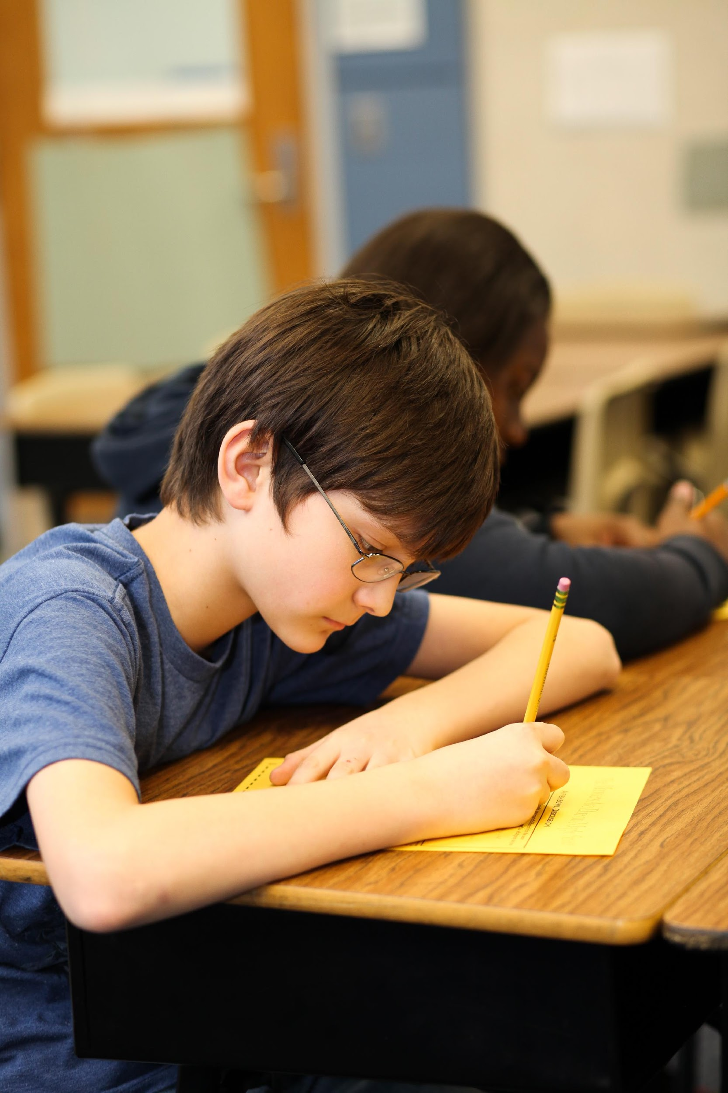
Middle school is a defining point for students in the college and career readiness process.
Source: The Forgotten Middle: Ensuring that All Students Are On Target For College and Career Readiness Before High School, ACT, 2008.

Slide 7
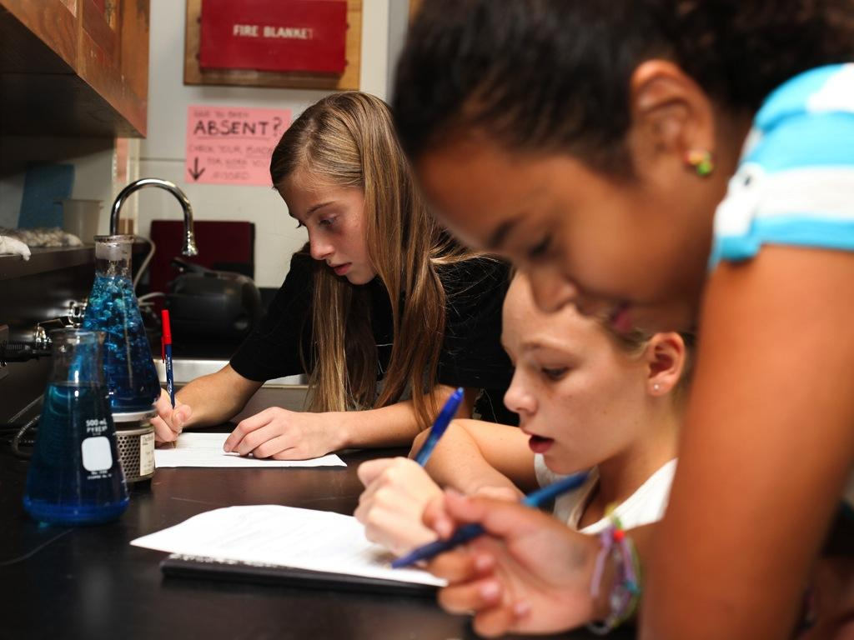
Preparing Students for the Future
Notes:
Seven Core Competencies that students will need to succeed in a world that has not yet been defined.
Collaboration
Agility
Initiative and entrepreneurial spirit
Effective Oral and Written communication skills
Able to not only access but also analyze information
Curiosity and imagination
Move away from banking model of education. Making deposits. Kids want to learn through experiencing and they gather information the internet. It’s more dynamic and there’s so much more mental stimulation involved with generating understanding.

Slide 8
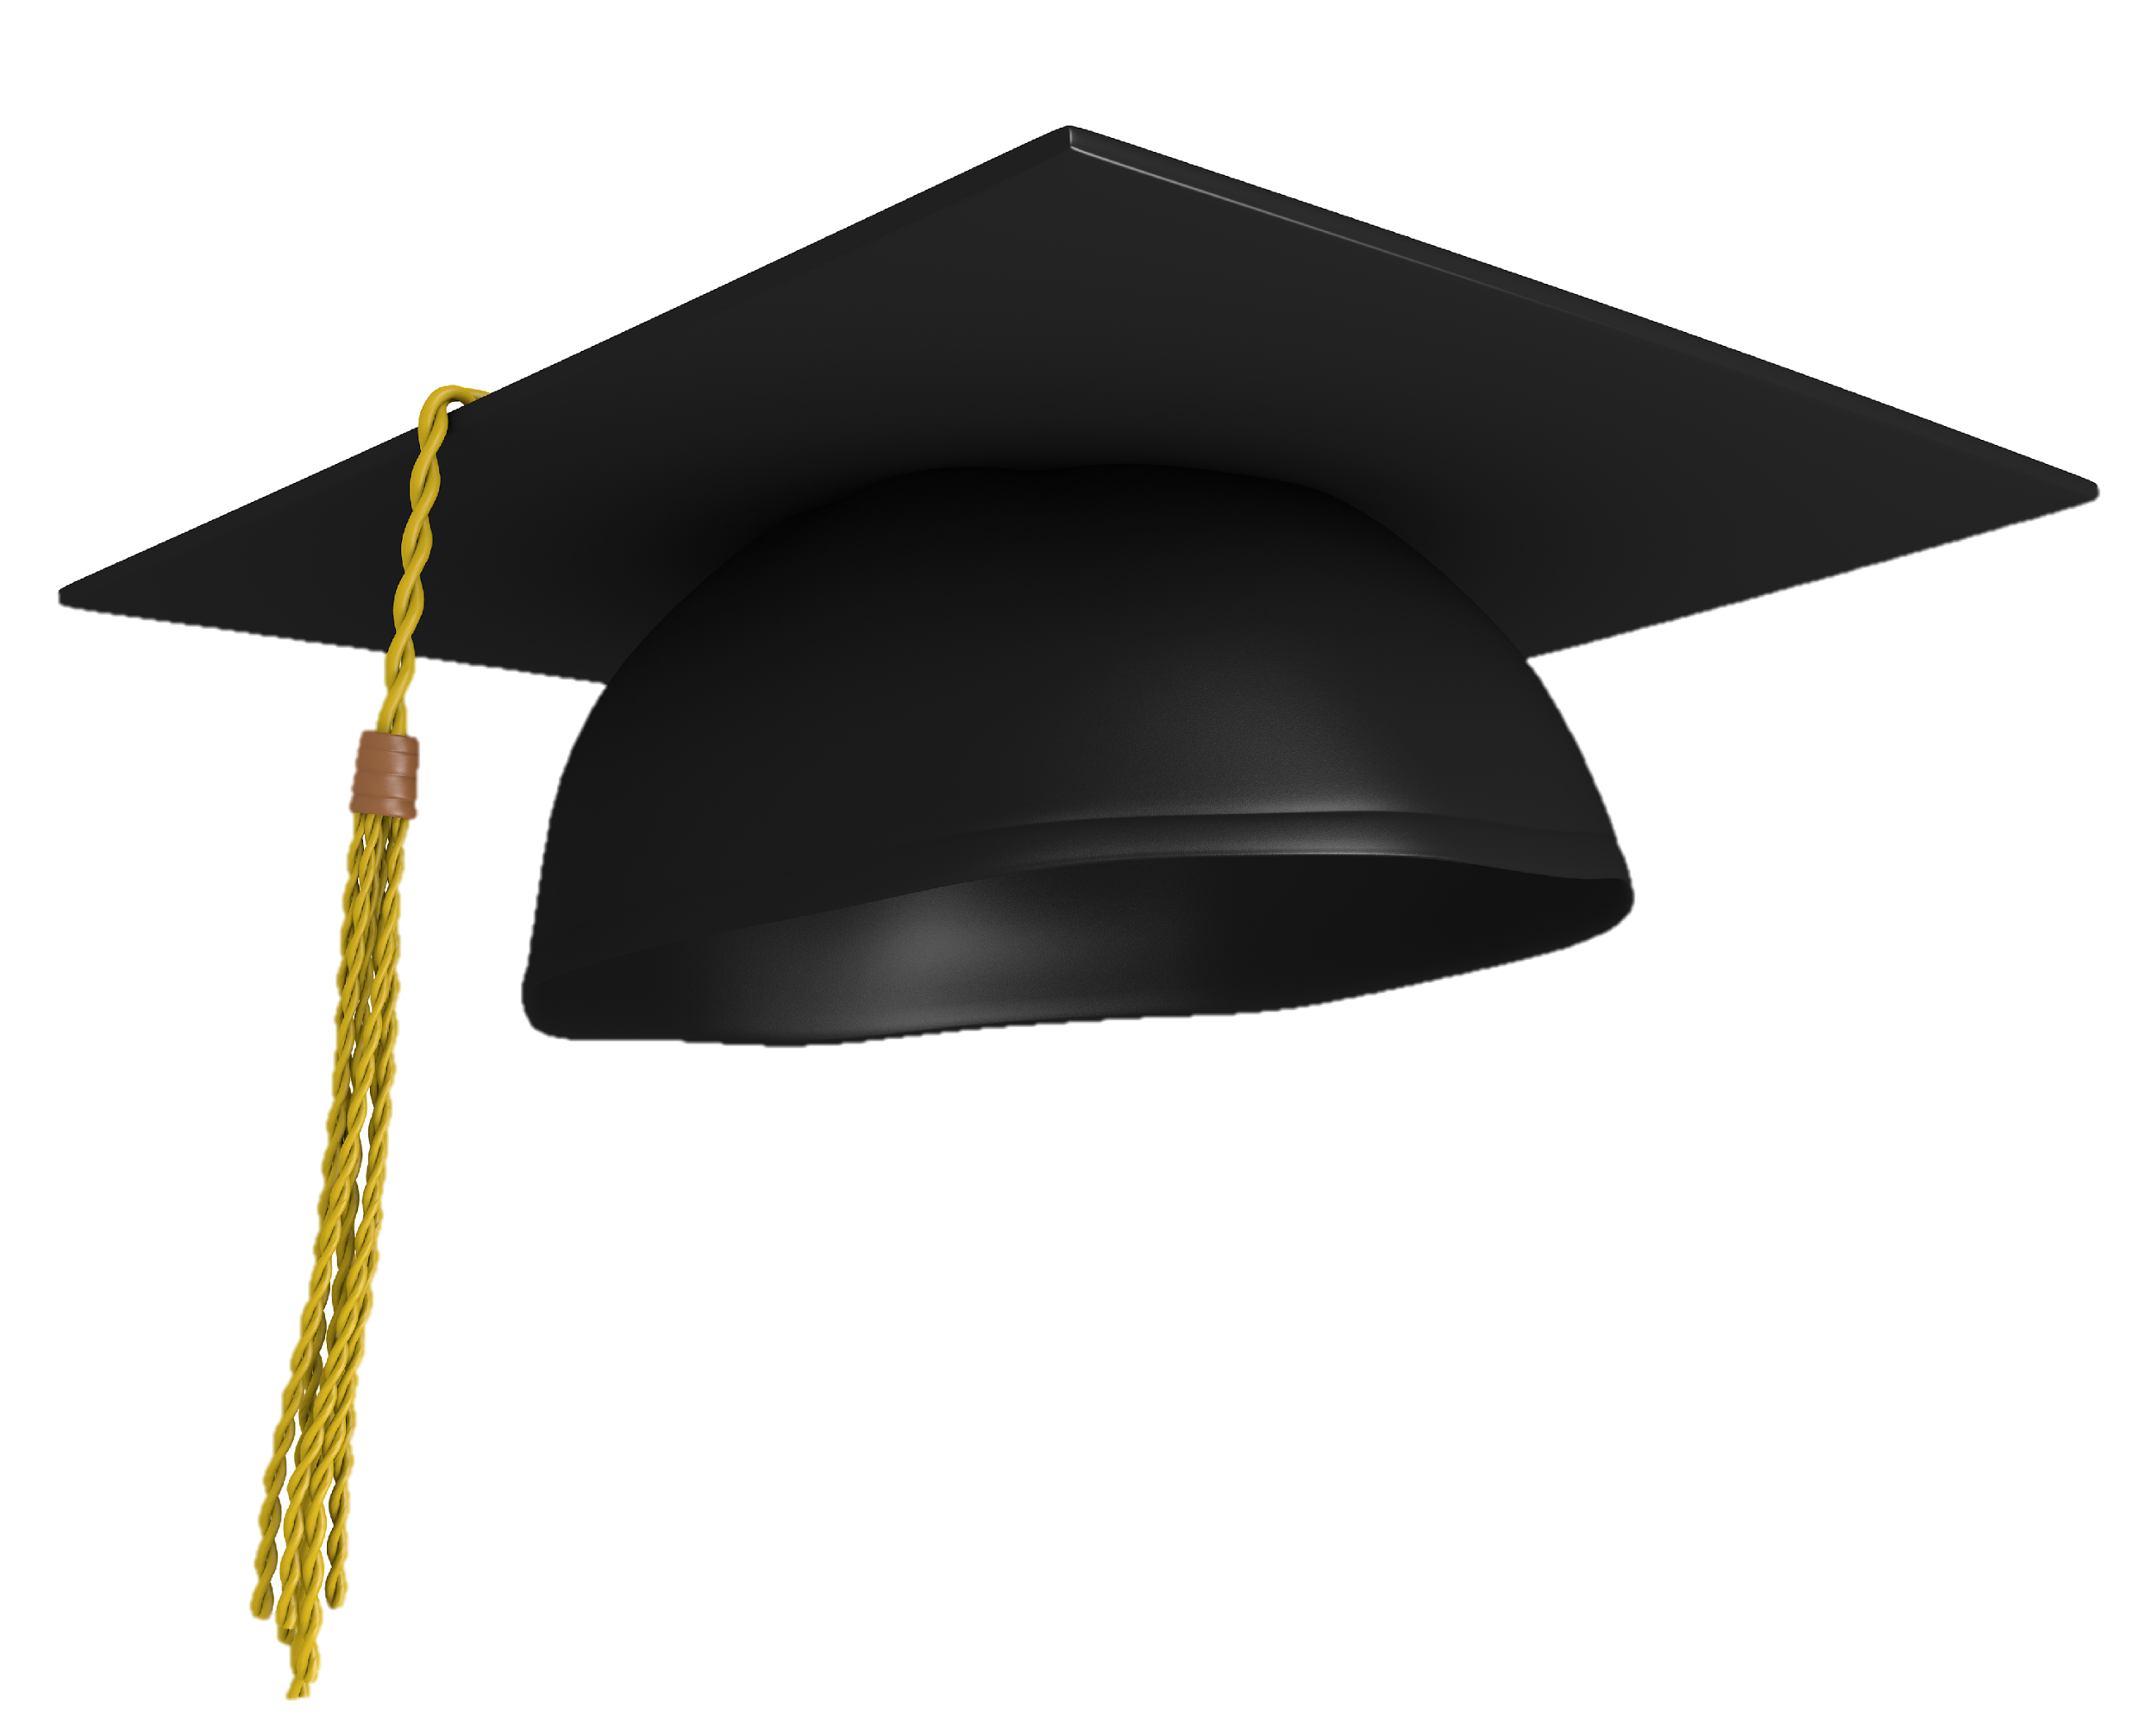
High School Readiness
College and Career Readiness
Notes:
This journey begins with the end in mind. Our goal is to help students graduate with their dreams in tact. We work to ensure that they graduate ready for success in college or career. In order to help students meet this expectation, it is critical to place them on the correct pathways to success.

Slide 9
21st Century Skills
High School Readiness
College and Career Readiness
Student Behaviors
Notes:
In middle school, preparing students for success in high school can be described by two components; possessing 21st century skills and student academic behaviors

Slide 10
Life and Career Skills
Learning and Innovation Skills
Information Media and Technology Skills
21st Century Skills
High School Readiness
College and Career Readiness
Student Behaviors
Notes:
What Knowledge and Skills will students need in the 21st Century?

Slide 11
Academics

Slide 12
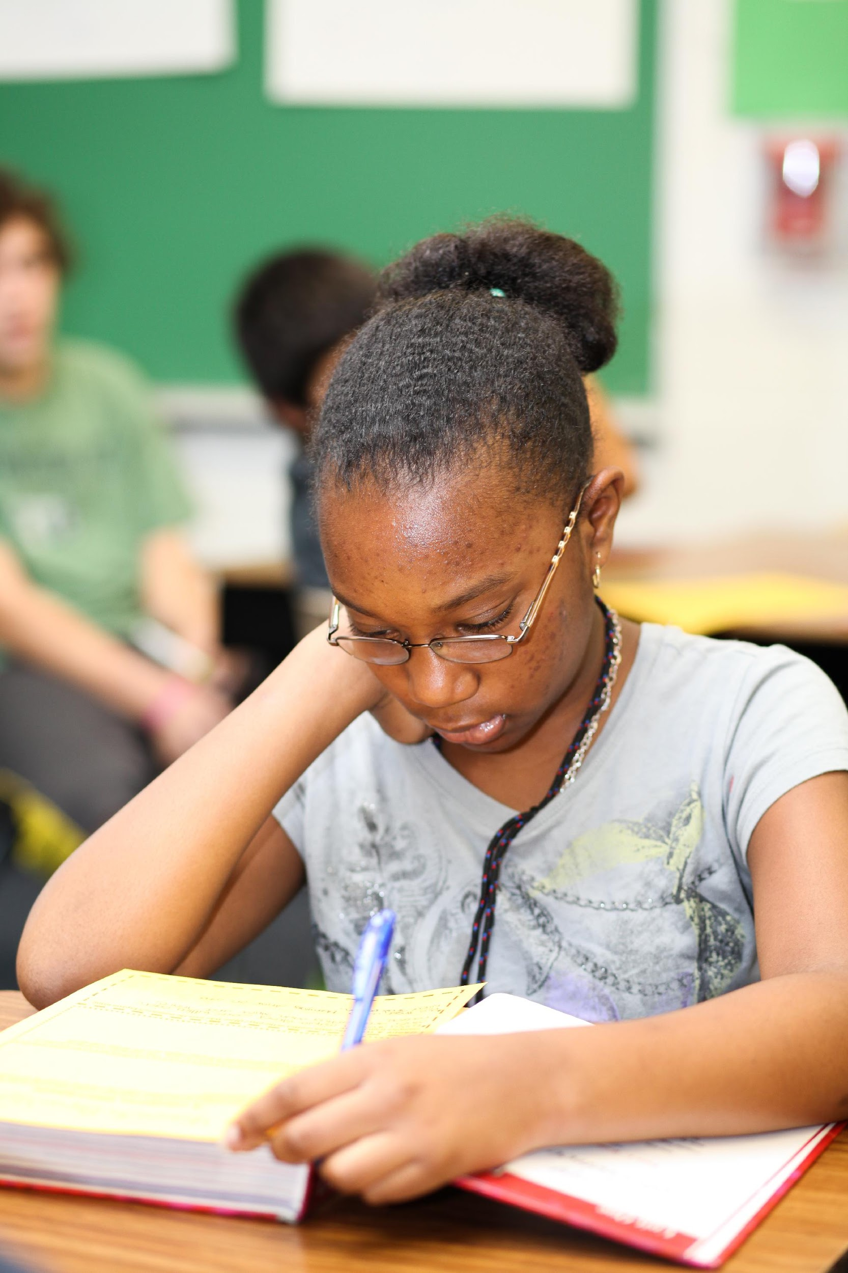
The level of academic achievement that students attain by eighth grade has a larger impact on their college and career readiness than anything that happens academically in high school.
Source: The Forgotten Middle: Ensuring that All Students Are On Target For College and Career Readiness Before High School

Slide 13
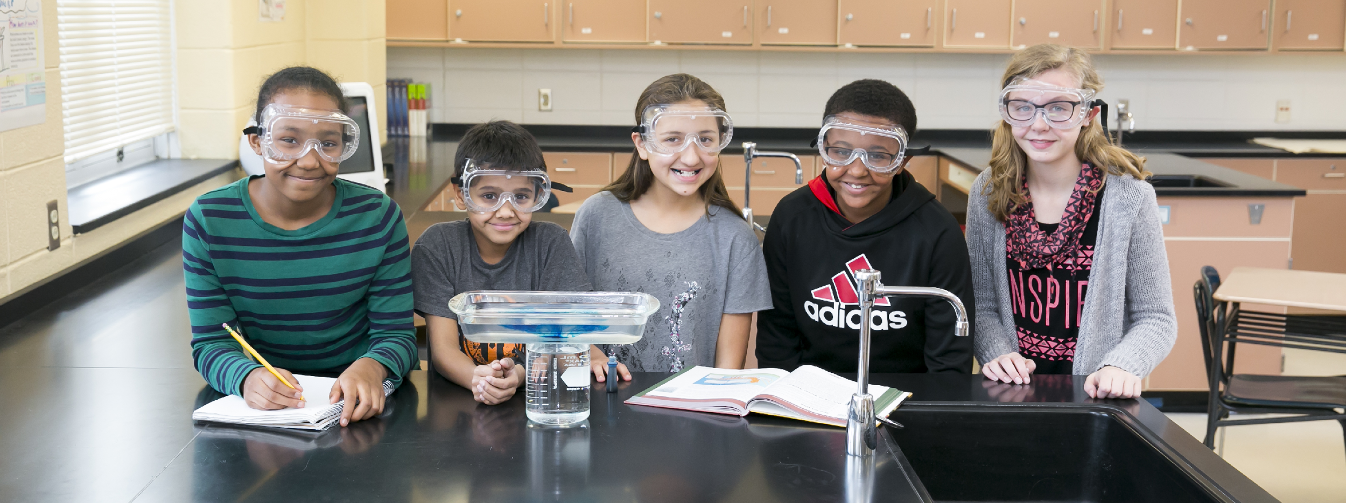
All students are enrolled in seven 50-minute classes every day.

Slide 14
All students receive daily instruction aligned to Maryland’s College and Career-Ready Standards in:
English
Mathematics
Social Studies
Science
Notes:
English, mathematics, science, and social studies.

Slide 15
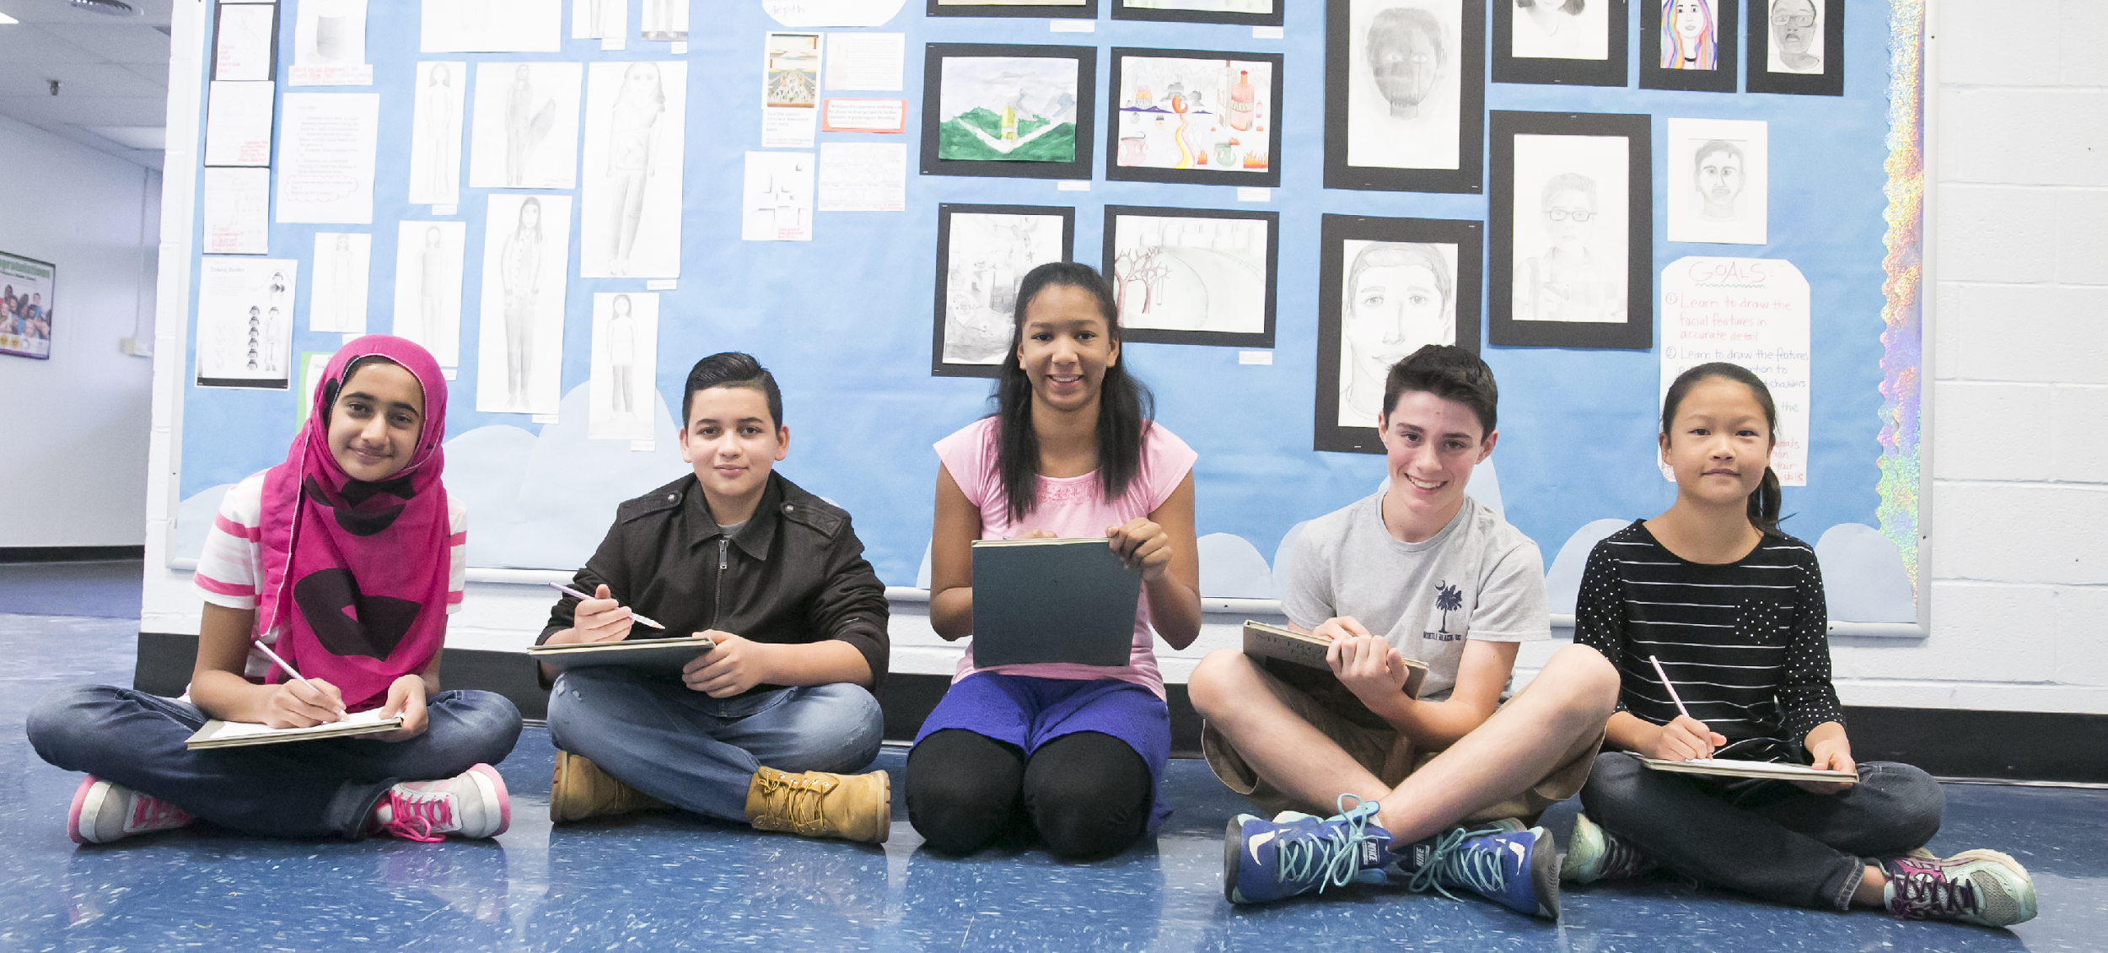
In addition, Maryland regulations require
all students take:
Health Education
Physical Education
Fine Arts (General Music and/or Visual Arts)
Notes:
In addition Maryland regulations require all students to take Health Education (a quarter long course, may be scheduled every other day for a semester), Physical Education (typically scheduled every other day for the entire year), and a Fine Arts (Art and/or Music) course every year.

